Slide 1

Santorini AI
Luka Žontar, Vid Stropnik

Slide 2
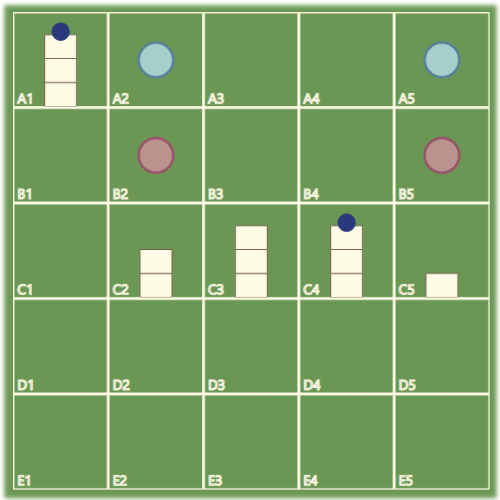
How to play?
2 pawns per player on 5x5 grid
Move & Build on adjacent space
Can build 1st, 2nd, 3rd level or roof
Can only move up 1 space
Goal: Reach 3rd level
We made a rules video! (Slovene, sorry)
https://bit.ly/AI-Santorini

Slide 3
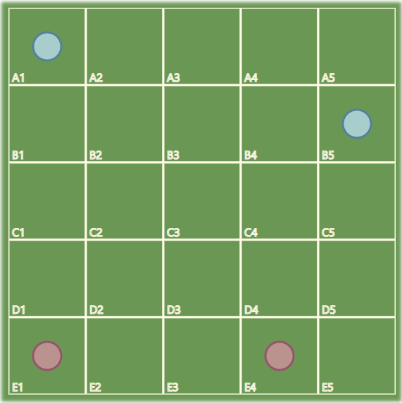
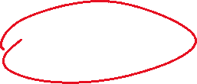
Baselines & challenges
Beat
Beat a random mover
Beat
Beat a mover that tries to move up
Beat
Beat a mover that knows ‘The One Pawn Rush’
Find
Find the best Agent

Slide 4
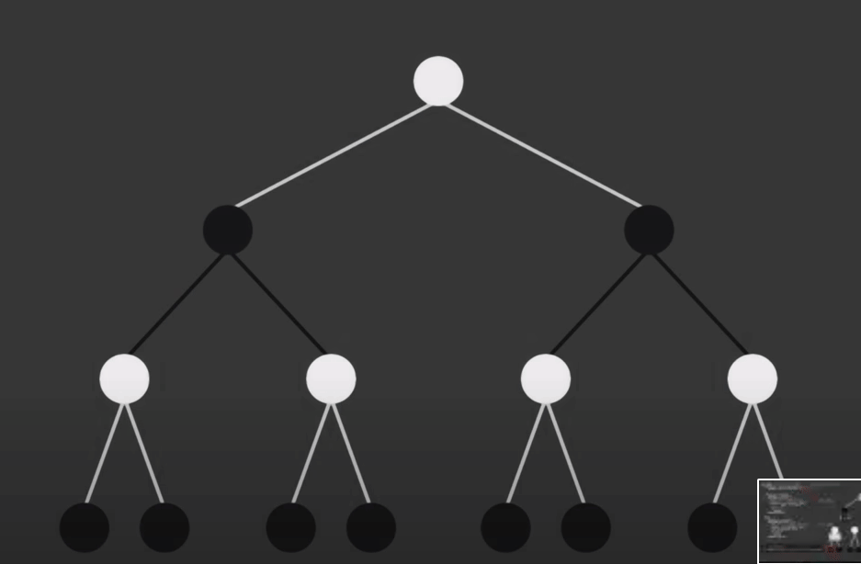
MinMax algorithm with alpha-beta pruninG
No external libraries used.
Game fully playable (PvP, PvAI) in browser or terminal GUI
Credit: Sebastian Lague

Slide 5
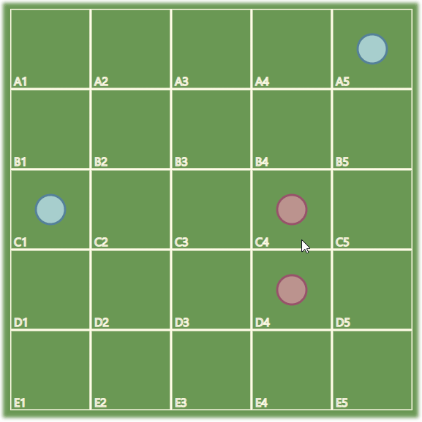
Heuristics
Sums of function values, applied to each pawn (+ for max, - for min):
Pawn height
Pawn neighborhood/possible moves height
Presence (and accessibility of) Win state
Distance from closest enemy
Combinatioons of the above

Slide 6
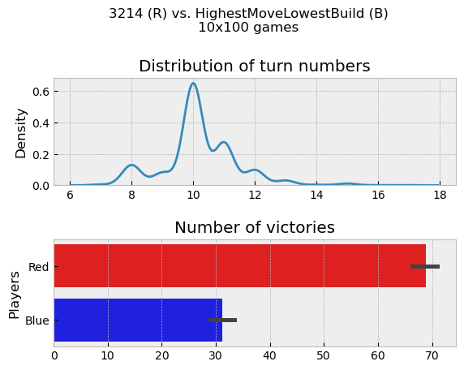
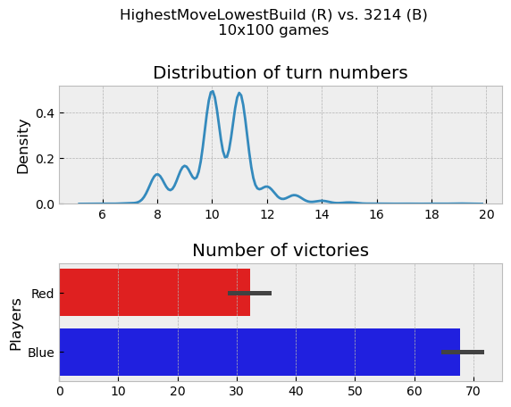
Baselines hmlb - 3214

Slide 7
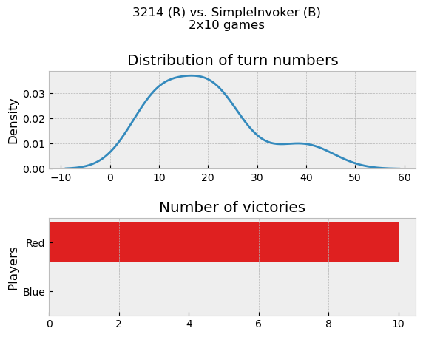
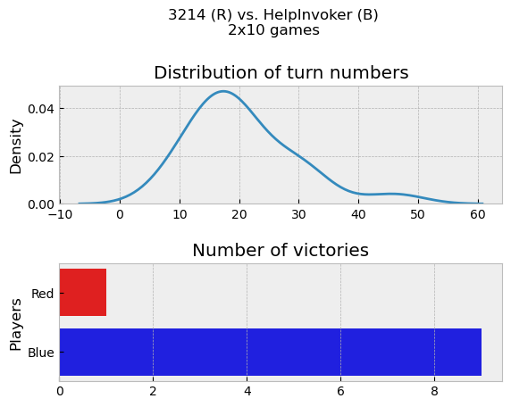
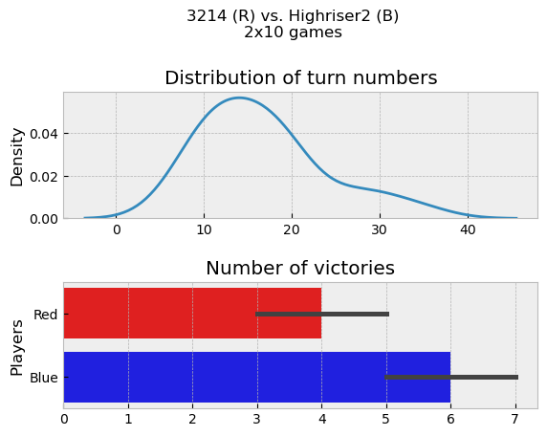
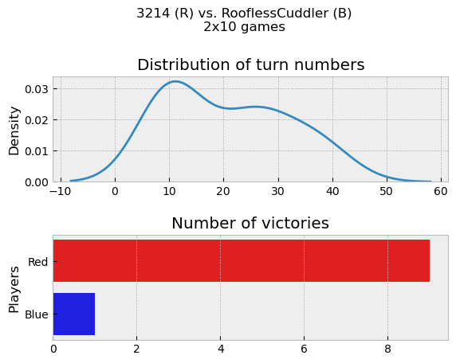
Versus baseline (always blue) (d=2)
HelpInvoker
Highriser2
RooflesCuddler
SimpleInvoker

Slide 8
Versus eachother

Slide 9
Versus us
...We’re too ashamed to show a graph here ☺

